Slide 1

Predictive Modeling And Analytics For Diabetes
Thank u
Objective
About
Conclusion
Scenario
Algorithm
Project.ID :12

Slide 2

Objective
Thank u
Scenario
about
Conclusion
Algorithm
Reg.no :- 17MIS0375
Name :- MANNAM BALA MURALI KRISHNA
Subject :- Data Mining Techniques
Slot :- F1+TF1
Course Code:- SWE2009

Slide 3
Scenario Considered
Diabetes Mellitus (DM) is a chronic disease and as per world health organization (WHO) statistics, around 350 million people were suffering with DM.
According to WHO it is seventh leading disease to cause of death by 2030 across the world.
Most of the diabetes they don't know they are suffering with diabetes.
The root cause of diabetes is inactive physical activities, obesity and food habits etc., there is a vast study and research is going on in the field of DM.
Thank u
Objective
about
Conclusion
Scenario
Algorithm

Slide 4
Cont’d
Recent years healthcare data is growing very vastly and it has different dimensions such as structured, semi-structured and unstructured.
Paper work and its analysis takes more time in providing services in the area of healthcare.
Thank u
Objective
about
Conclusion
Scenario
Algorithm

Slide 5
Objective
Approach considers diabetes dataset in its experimentation because it's a life threatening chronic disease.
In this proposed approach different machine learning algorithms of different representations and mode of learning styles are considered in predicting diabetes type and based on the predictions we analyzed accuracy of individual algorithm.
As a result we identified most accurate algorithm which predicts data accurately with compared to other algorithms.
Thank u
Scenario
Conclusion
about
Algorithm
Objective

Slide 6
Dataset Description
Number of features or attributes are 8.
Attribute names are
Pragnecias
Glucose
Blood plessure
Skinthickness
Insulin
BMI
Diabetes pedegree function
Age
Number of rows are 2001.
Scenario
Thank u
about
Conclusion
Dataset
Algorithm

Slide 7
Tool Used
Python IDLE
IDLE is Python's Integrated Development and Learning Environment. IDLE has the following features: coded in 100% pure Python, using the tkinter GUI toolkit.
Thank u
Scenario
about
Conclusion
Objective
Tools

Slide 8
Algorithms Used
Random Forest Classifier.
Multifactor dimensionality reduction(MDR) classifier
Scenario
Thank u
Objective
Conclusion
about
Algorithm

Slide 9
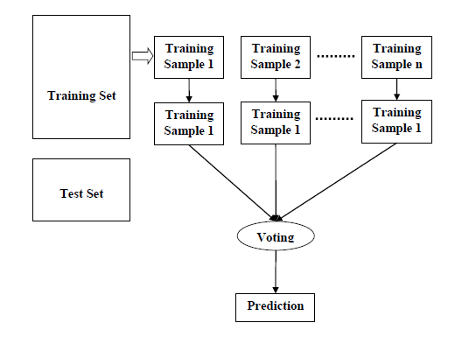
Random Forest
Scenario
Thank u
Objective
Conclusion
about
Algorithm

Slide 10
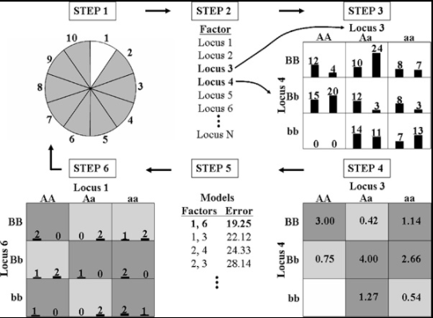
MDR
Scenario
Thank u
Objective
Conclusion
about
Algorithm

Slide 11
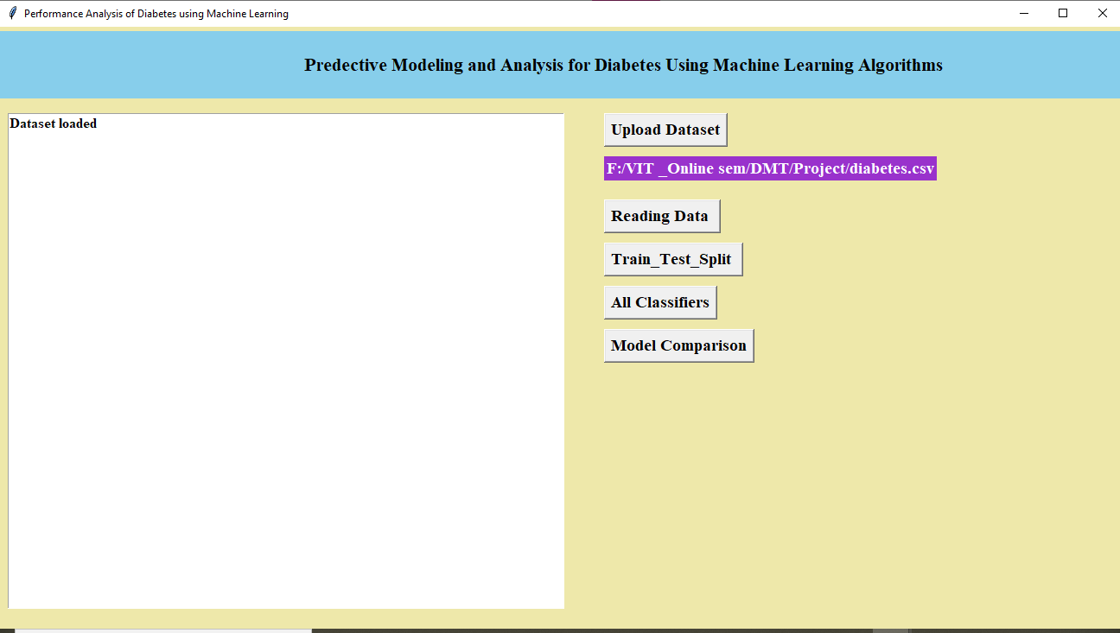
Snap Shots
Scenario
Thank u
Objective
Conclusion
about
Snapshots
Loading of dataset

Slide 12
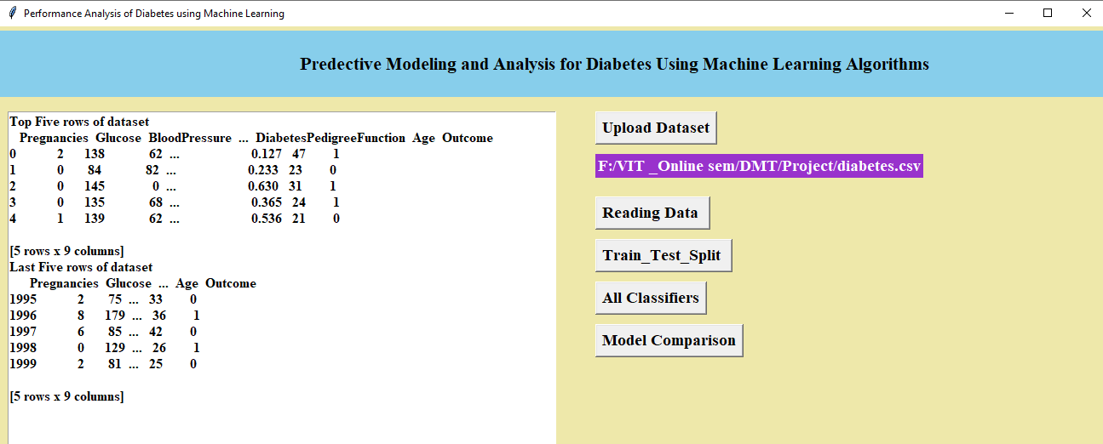
Snap Shots
Scenario
Thank u
Objective
Conclusion
about
Snapshots
Reading the data from the provided Dataset

Slide 13
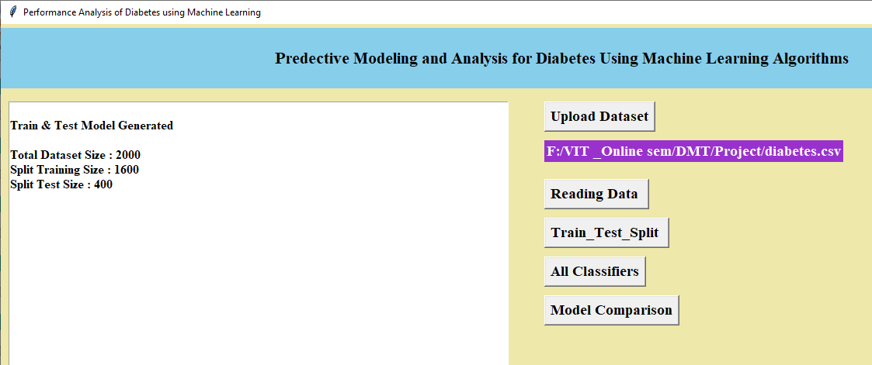
Snap Shots
Scenario
Thank u
Objective
Conclusion
about
Snapshots
Splitting Training and Testing data

Slide 14
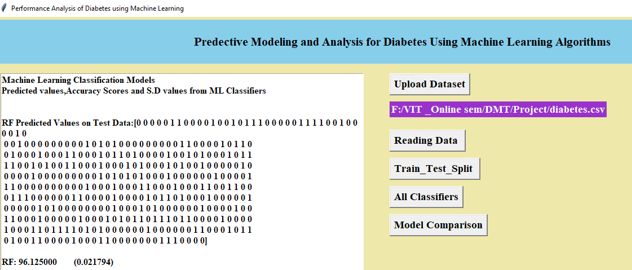
Snap Shots
Scenario
Thank u
Objective
Conclusion
about
Snapshots
Random Forest Predicted Values on Test Data is 96.125%

Slide 15
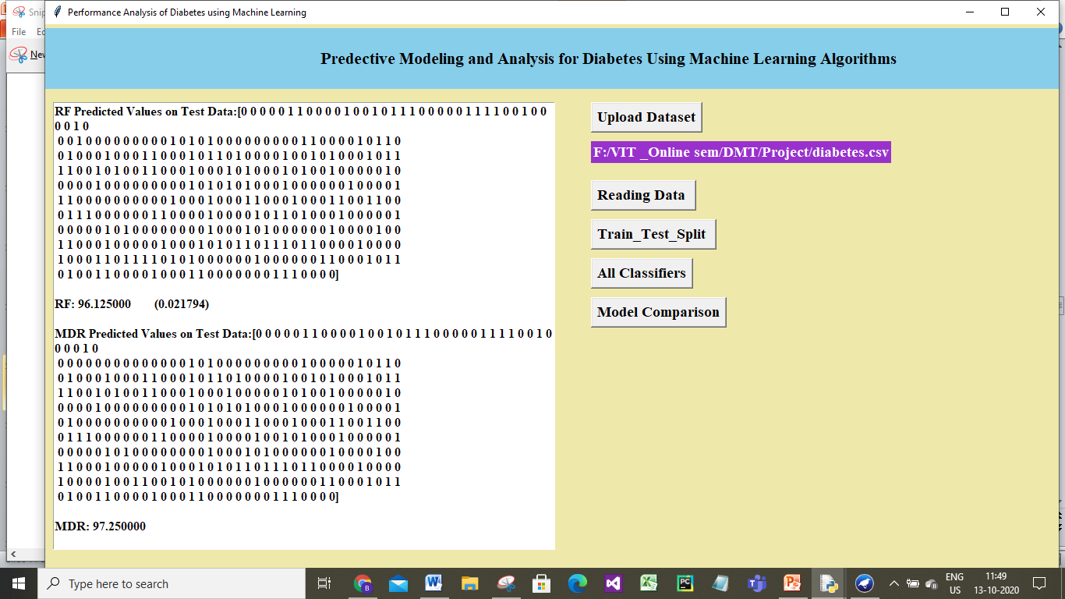
Snap Shots
Scenario
Thank u
Objective
Conclusion
about
Snapshots
MDR Predicted Values on Test Data is 97.25%

Slide 16
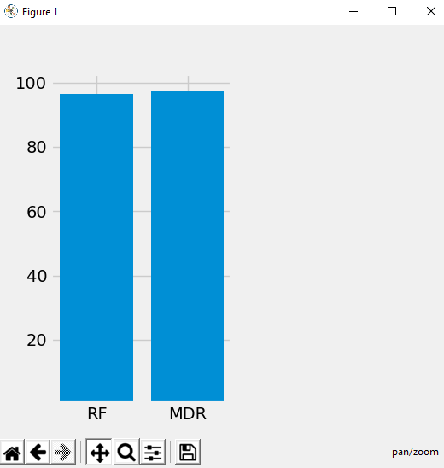
Visual Representation
Scenario
Thank u
Objective
Conclusion
about
Analysis

Slide 17
Concluding Remarks
Both the algorithms generate model from train dataset and new data will be applied on train model to predict it class.
Because both algorithms best supports for classification
Thank u
Objective
Conclusion
about
Algorithm
Scenario

Slide 18
References
Dataset Link:
https://github.com/BalaMurali287/MyDatasets/blob/master/diabetes.csv
Other Links:
https://www.longdom.org/open-access/late-stage-complications-of-diabetes-and-insulin-resistance-2155-6156.1000167.pdf
https://www.researchgate.net/publication/320147586_Personal_Discovery_in_Diabetes_Self-Management_Discovering_Cause_and_Effect_Using_Self-Monitoring_Data
https://science.sciencemag.org/content/349/6245/255
https://pubmed.ncbi.nlm.nih.gov/16595076/
Thank u
Objective
References
about
Algorithm
Scenario

Slide 19
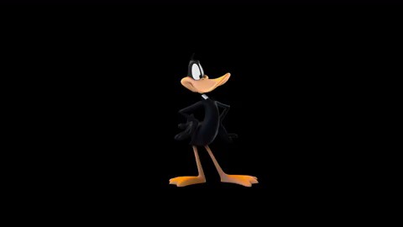
Thank u
Objective
Conclusion
about
Algorithm
Scenario
THANK YOU

